Slide 1
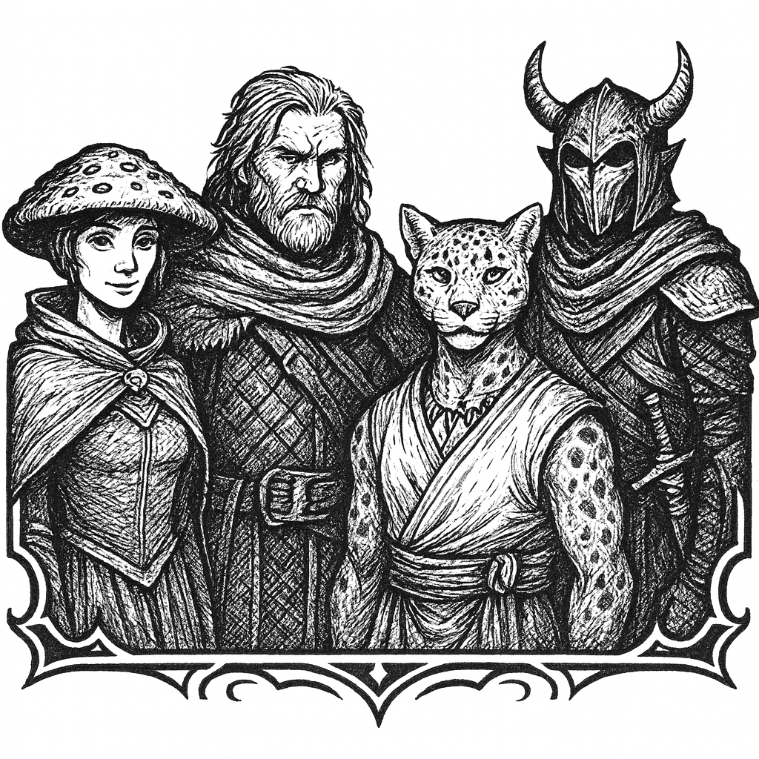
Vaelora - Character
Name:
Player:
Species:
Culture:
Background:
Concept:
Age: □ C □ YA □ A □ MA □ V - _______________
Attributes
Skills
Body | Might
 | Agility
 | Fortitude
Mind | Wit
 | Focus
 | Presence
Soul | Presence
 | Spirit
 | Cunning
Martial |  | Exploration |  | Social |  | Magic
Melee |  | Athletics |  | Persuasion |  | Attune
Brawl |  | Stealth |  | Deception |  | Rituals
Archery |  | Survival |  | Intimidate |  | Occultism
Dodge |  | Ride |  | Empathy |  | Meditation
Tactics |  | Navigation |  | Etiquette |  | Alchemy
Sieges |  | Climibing |  | Seduction
Throwing |  | Swimming |  | Perform
Shields |  | Tracking |  | Inquire
Knowledge |  | Crafts |  | Investigation |  | Politics
History |  | Smithing |  | Observation |  | Command
Theology |  | Mechanics |  | Investigate |  | Bureaucr.
Language |  | Weaving |  | Streetwise |  | Espionage
Zoology |  | Cooking |  | Subterfuge |  | Trade
Mechanics |  | Drawing |  | Forgery |  | Law
Philosophy |  | Carpentry |  | Interrogate |  | Diplomacy
Maths |  | Masonry |  | Evasion |  | Politics
Herbalism |  | Medicine |  | Smuggling |  | Finances

Slide 2


Vaelora - Character
Name:
Player:
Item | Tags | Item | Tags

