Slide 1
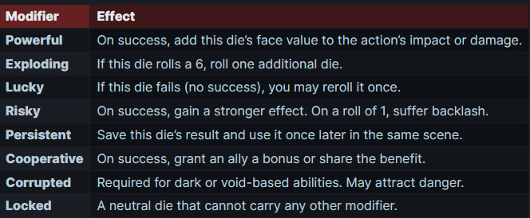
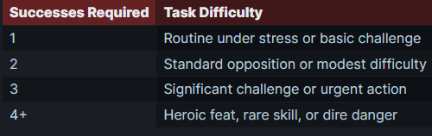
Vaelora – Quick Rules Overview
Core Concept
Marked Dice
"The world is vast and veiled, its truths hidden in whispers of spirit and shadow. Every choice resonates - through flesh, will, and soul.“
Vaelora is a dangerous, spirit‑haunted world. These rules provide the essentials to quickly run dramatic adventures filled with combat, social intrigue, and spiritual consequence.
Some abilities let you mark dice with special modifiers. Each marked die may only hold one modifier.
Primary Attributes
Every character has 8 Attributes (0–5):
Might: Strength, athleticism
Agility: Reflexes, mobility
Fortitude: Endurance, toughness
Wit: Awareness, quick thinking
Focus: Mental discipline
Presence: Charisma, leadership
Spirit: Willpower, spiritual strength
Cunning: Instinct, guile
Dramatic Systems
Fatigue
You may be forced to spend Fatigue but you can also spend it voluntarily for:
Overexertion: Lower the action cost in combat by 1
Try Hard: Reroll up to 3 dice of a pool
Push Through: Get +1 die to a pool
Secondary Attributes
Corruption
Secondary | Formula | Effect
Health | Might + Fortitude | Injuries you can take before being incapacitated.
Face | Spirit + Focus | Slights you can take in social conflicts before Faltering.
Initiative | (Wit + Agility + Cunning) ÷ 2 | Adds to Initiative rolls at combat start.
Fatigue | Fortitude + Spirit | At 0: –2 dice to all actions (Exhausted).
Speed | Agility × 2 | Distance moved per round (×3m per point); used in chases.
Burden | Might + Fortitude | Heavy items carried before penalties (–1 die and half Speed each).
Some actions or exposure to the Void may give you Corruption. It is powerful, but dangerous:
You may add Corruption to all your die roles as additional dice with the Curropted marker.
Some rolls require you to add Corruption to them.
A 1 on any Corruption Die triggers a Backlash
A 6 on any Corruption Die triggers a Tainted Success
Advancement
In Vaelora you advance through earned Marks.
Gain a mark in a skill (or attribute) when you fail a test
Spend marks to:
  Raise an Attribute: new rank x 10
  Raise a Skill: new rank x new rank
  Learn Abilities: Tier x 3
Core Resolution System
Dice Pools
Build a dice pool = Attribute + Skill Roll that many d6s.
5 or 6 = success, 1–4 = failure.
Compare your total successes to the Difficulty (1–4) set by the GM.
Contested Roll: Opposing sides roll pools; more successes wins.
Resistance Roll: Roll to reduce harm/effects when enduring danger.
Teamwork: Allies can support a character’s roll; each helper rolls a relevant pool, and on at least 1 success, grants +1 die (must mark a Cooperative die).
Group Rolls: Everyone rolls; if combined successes meet the GM’s threshold, the group succeeds OR Teamwork.
Social Intrigue
Goes in rounds, each participant hase 1 action per turrn.
  Engage: Persuade, charm, deceive, intimidate (inflict Slights).
  Defend: Fortify composure to resist Slights.
  Observe: Gather leverage or weaknesses.
  Recover Composure: Remove 1 Slight.
Slights: Emotional/social damage tracked against your Face.
  If Slights ≥ Face, you Falter (break down, withdraw, lash out, or submit).
Bonds & Leverage: Emotional ties, secrets, or advantages can add dice, rerolls, or force Faltering.
Approaches: Charm, Deceive, Persuade, Command, Invoke.
Victory: Reduce your opponent to Faltering or achieve your goal narratively.

Slide 2

Vaelora – Quick Start Guide
Combat
Option | Roll | Alternate Effect
Evade | Agility + Dodge | Reduce defence penalties.
Riposte | Agility + Weapon Skill | If you win, deal margin as damage; if you lose, take extra injuries.
Block | Agility + Shields | Penalize attacker’s next action.
Parry | Agility + Weapon Skill | Margin adds dice to your next attack.
Armour | Flat dice from armor | Costs no AP, has no multi-defense penalty
Action Point Reserve
APR = 1 + (agility + Focus + Wit) / 3
Each character has an APR pool that refreshes at the start of their turn.
You may hold back APR for defensive actions.
You Spend Action Points (AP) in your turn to:
Action | APR Cost
Move up to Speed | 1
Dash (double Speed) | 2
Strike with a weapon | 2
Block, Parry, Counterattack, Disarm, Trip, Grapple | 1
Use bound spirit ability | 1–3
Rely on Armor (Soak Dice) | 0
Ready an action (specify trigger) | 2
Injuries, Trauma & Healing
Injuries represent serious harm (wounds, trauma, exhaustion); they don’t reset automatically.
Track total Injuries vs Health:
  Healthy: Fewer than 50% of Health lost; no penalties.
  Wounded: >50% of Health lost; –2 dice to strenuous actions, halved APR.
  Overwhelmed: Injuries = Health; halve all pools, one action max per round.
  Subdued: Injuries exceed Health; incapacitated or at GM’s discretion (dying, captured, or maimed).
Trauma: After combat, roll 1d6 per unhealed Injury; failures may cause temporary or permanent conditions (GM chooses).
Healing:
  Rest: Fortitude roll after secure rest; each success heals 1 Injury.
  Medical Treatment: Wits + Medicine roll; successes can heal immediately or boost recovery rolls.
  Unhealed Injuries may become permanent if left untreated too long.
  Armor and magic can prevent or reduce Injuries, but do not replace healing.
Initiative & Turn Order
2d6 + Initiative
At the start of combat roll Initiative. This is the order of turns. Highest Initiative goes first.
Every round you:
  Start of Turn Effects: Resolve any conditions, auras, or cooldowns.
  APR Refresh: Reset APR to maximum.
  Declare and Execute Actions: Spend APR on actions. Players are encouraged to describe intentions and be cinematic.
  End of Turn Effects: Handle any ongoing effects, checks, or triggers.
Complex Enemies and Player Characters go first, then Simple Enemies act.
Complex & Simple Enemies
Complex Enemies act like player characters.
Simple Enemies have a fixed DC to either attack against or resist. If you fail they have an effect (e.g. Injury) on you.
Attacks & Defenses
Intrigue in Combat
Attacks are a Roll for Might|Agility + Skill + Weapon vs. Defense.
The success margin equals the Injuries taken.
All defence can reduce the wounds you take.
Each Defence you make incurs a -2 die penalty on the next defense in this round.
Specific defence options can have additional effects:
You can spend APR on a social action instead of a physical one (usually 2 APR).
Roll as normal: Build a pool using the most fitting Approach + Skill (e.g., Presence + Command, Spirit + Invoke).
Effects:
  Create or break Bonds (for leverage in future rolls).
  Inflict Slights (like in social intrigue); if a target’s Face is exceeded, they Falter (lose their composure, hesitate, or withdraw).
  Rally or demoralize allies/enemies, granting dice bonuses or imposing penalties.

